Slide 1

PREPARED FOR
NewsKarnataka
Spearhead Media Pvt Ltd · Mangaluru, Karnataka
Advanced
News Platform
A premium iOS, Android and web experience with AI-driven hyperlocal news — built and shipped in eight weeks.
PROPOSAL BY
Opus Infinite
TIMELINE
SCOPE
VERSION
Product engineering & applied AI
8 weeks to launch
iOS · Android · Web · PWA
V1.0 · 03 Sep 2026
Confidential — prepared solely for News Karnataka / Spearhead Media Pvt Ltd
Notes:
Cover. Confirm client entity name, logo placement and proposal version before issuing.

Slide 2
CONTENTS
What's in this proposal
01
The Brief
03
Technology
05
Delivery & Commercials
Executive summary
3
Solution architecture
17
8-week plan
29
Understanding News Karnataka
4
Technology stack
18
Weeks 1–4
30
The opportunity
5
Infrastructure & scale
19
Weeks 5–8
31
Objectives & definition of done
6
Security, privacy & compliance
20
Team & governance
32
Performance & SLA
21
Investment summary
33
02
The Product
Payment milestones & AMC
34
04
Business Case
Risks & assumptions
35
Product at a glance
8
Deliverables & acceptance
36
Location-first news hierarchy
9
Three revenue streams
23
Why Opus Infinite
37
The AI layer
10
Advertising & real estate
24
Next steps
38
Reading experience
11
Subscriptions
25
Engagement & community
12
Revenue ramp
26
Discovery & personalisation
13
Success metrics
27
Kannada + English by design
14
Newsroom console
15
Advanced News Platform · Proposal for News Karnataka
Opus Infinite
2
Notes:
Index. Page numbers match the printed slide numbers in the footer circles.

Slide 3


PART 01 · THE BRIEF
Executive summary
What we propose to build, why it wins, and what it takes.
8 wks
3
2
3
Design to store launch
Platforms from one codebase
Languages at launch
Revenue streams live
Four two-week sprints, demo at every gate
iOS, Android and web + installable PWA
Kannada and English, switchable in-app
Advertising, subscriptions, classifieds
The proposition
What you get at the end of week 8
14 years of trusted Karnataka reporting in two languages — the content advantage already exists.
What is missing is a product that puts the right story in front of the right reader, in their language and their city, within seconds.
We build it: a native-quality app and web experience where AI weights every feed toward the reader's own location first.
Monetisation is designed in from sprint one, not retrofitted after launch.
Production apps on both stores, plus a web app and installable PWA.
An AI service that tags every story by location, topic and urgency automatically.
A newsroom console your editors control — no developer needed to push breaking news.
Ads, subscriptions and classifieds wired, tested and reporting.
Two weeks of hypercare, then an optional AMC.
Advanced News Platform · Proposal for News Karnataka
Opus Infinite
3
Notes:
Lead with the proposition, not the tech. The four tiles are the headline commitments.

Slide 4






PART 01 · THE BRIEF
Understanding News Karnataka
Everything below shapes a design decision later in this document.
Publishing since 2012
Rooted in coastal Karnataka
Genuinely bilingual
Launched as a Kannada platform in May 2012, with the English portal added in March 2013 — two established audiences, not one.
Headquartered in Mangaluru with strong Mangaluru–Udupi readership, alongside Bengaluru and Mysuru coverage.
Kannada and English editions running in parallel. Language is a first-class product axis, not a translation afterthought.
Broad desk coverage
Already multi-platform
Standards-led newsroom
Karnataka, India, World, Sports, Entertainment, Business, Education, Technology, Gaming and Lifestyle.
Active on Facebook, Instagram, WhatsApp, YouTube, X, Threads and Google News — an owned app closes the loop.
Published ethics, fact-checking and corrections policies. The product must visibly reflect that credibility.
The design consequence: a reader in Udupi and a reader in Bengaluru should not see the same feed, and a Kannada reader should never be served an English-only experience. Location and language are the two axes every screen in this proposal is built around.
Advanced News Platform · Proposal for News Karnataka
Opus Infinite
4
Notes:
Source: newskarnataka.com home page and About Us, retrieved 03 Sep 2026. Verify readership figures with the client before quoting any.

Slide 5



PART 01 · THE BRIEF
Why an owned app, and why now
Four structural shifts that make this the right build at the right time.
Mobile-first readership
Push beats the algorithm
Hyperlocal is under-served
First-party data sells
Regional news reading in India is overwhelmingly mobile and increasingly app-led. A browser tab competes for attention; a home-screen icon owns it.
Social reach is rented and volatile. Push notifications to your own installed base are a direct, unmediated channel to readers you already earned.
National apps cover Karnataka thinly and the coast barely at all. A location-first feed is a position they cannot copy cheaply.
Logged-in readers with known city, language and topic interests let you sell geo- and interest-targeted inventory at far better rates than generic banners.
The risk of waiting
Every month without an owned app is a month of reader relationships mediated by someone else's ranking algorithm — and a month of ad inventory sold on someone else's terms. Regional publishers who moved early on apps now own their most valuable audience segment outright; those who waited are still buying reach back from platforms.
Advanced News Platform · Proposal for News Karnataka
Opus Infinite
5
Notes:
Framing slide. The market claims here are directional, not cited statistics — replace with client-verified analytics if available.

Slide 6
PART 01 · THE BRIEF
Objectives & definition of done
Five objectives, each with the test that proves we met it.
# | Objective | What it means in the product | How we prove it at handover
1 | Launch on all three platforms | Native-quality iOS and Android apps plus a responsive web app and installable PWA | Live store listings and a public web URL, all serving the same content API
2 | Make the feed feel local | AI weights every reader's feed toward their own city before regional, national and world news | Two test accounts in different cities produce measurably different feeds
3 | Serve both languages equally | Kannada and English throughout, switchable without losing session or position | Full UI, notifications and feed verified in both languages
4 | Turn readers into a community | Threaded comments, reactions, bookmarks and one-tap sharing on every story | Moderation queue live; engagement events flowing into analytics
5 | Earn from day one | Ad slots, subscription billing and classifieds all wired before launch, not after | Test transactions completed end to end in each of the three streams
Out of scope for these eight weeks: content migration of the existing archive beyond a defined cut-off, video production, a redesign of newskarnataka.com itself, and print workflows. Each can be quoted separately.
Advanced News Platform · Proposal for News Karnataka
Opus Infinite
6
Notes:
The right-hand column is the acceptance test. Agreeing this table up front is what prevents scope disputes in week 7.

Slide 7

1
Product at a glance
2
Location-first news hierarchy
PART 02
3
The AI layer
The Product
4
Reading experience
5
Engagement & community
What the reader sees, what the newsroom controls, and the intelligence between them.
6
Discovery & personalisation
7
Kannada + English by design
8
Newsroom console
Advanced News Platform · Proposal for News Karnataka
Opus Infinite
7

Slide 8











PART 02 · THE PRODUCT
Product at a glance
Twelve modules across three surfaces — reader, intelligence and newsroom.
READER APPS
INTELLIGENCE LAYER
NEWSROOM CONSOLE
Localised feed
Story classification
Publish & schedule
Story reader
Location relevance
Comment moderation
Comments & reactions
Trending detection
Live analytics
Bookmarks & offline
Personal ranking
Ads & subscriptions
Advanced News Platform · Proposal for News Karnataka
Opus Infinite
8
Notes:
Use this as the map for the rest of Part 02 — each following slide zooms into one column.

Slide 9
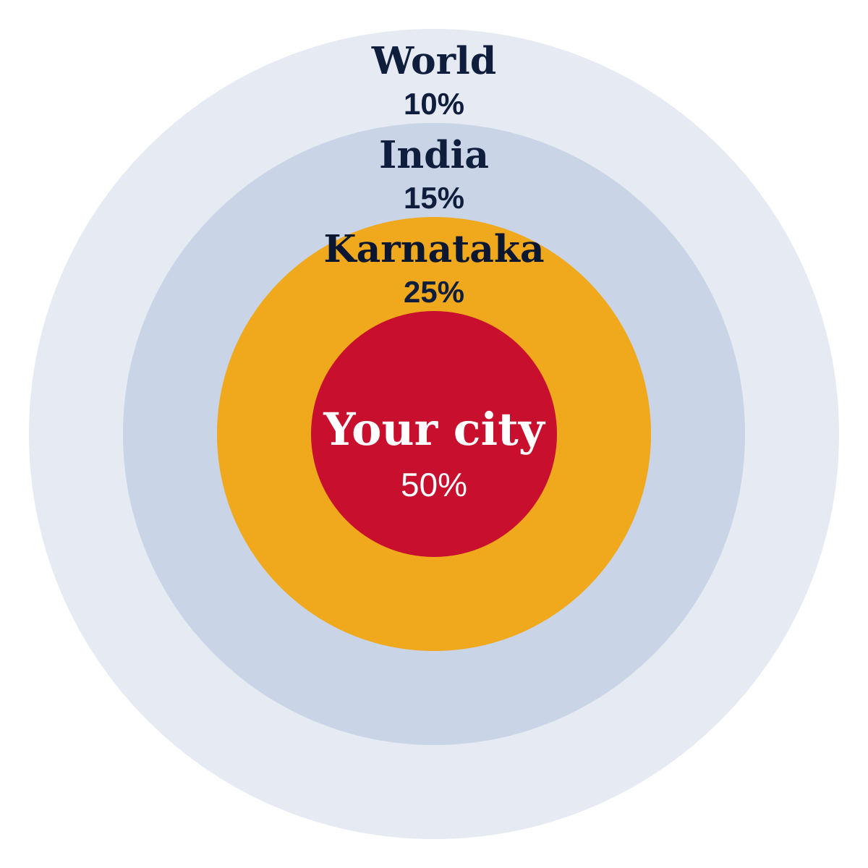
PART 02 · THE PRODUCT
Location-first news hierarchy
The single design decision that makes this app feel different from every national news app.
Every feed is assembled from four concentric rings, weighted by default and tunable by the reader.
Your city — 50%
Bengaluru, Mangaluru, Mysuru, Udupi and beyond, down to ward and neighbourhood tags where the story supports it.
Karnataka — 25%
State politics, civic decisions, weather and transport that affect the reader wherever they are in the state.
India — 15%
National stories that matter locally, surfaced with the Karnataka angle first where one exists.
World — 10%
Global headlines kept deliberately light so the feed never drifts away from home.
Reader control: readers can follow several cities at once, and the mix adapts to what they read.
Advanced News Platform · Proposal for News Karnataka
Opus Infinite
9
Notes:
Default weights are a starting point tuned in week 5 against real reading data; editors can override per city.

Slide 10





PART 02 · THE PRODUCT
The AI layer
Four jobs, all invisible to the reader — they just see a feed that fits.
1. Ingest
2. Classify
3. Geo-tag
4. Rank
Story arrives from the CMS or wire feed
Topic, entities, sentiment, urgency
City, district and landmark extraction
Scored per reader, per session
Fast enough to be invisible
Trending, and about to trend
Guardrails on the model
Groq-hosted inference returns classification in well under a second, so tagging happens as the editor hits publish.
Ranking is precomputed per city and per topic cluster, then personalised at request time from cache.
No reader ever waits on a model call to see their feed.
Reads, shares and comments tracked in rolling windows, per city not statewide.
A story spiking in Mangaluru surfaces there first instead of waiting for statewide volume.
Breaking-news candidates are flagged for a one-tap editor push — the human stays in the loop.
AI assigns tags and scores. It never writes or rewrites copy.
Editors override any tag, and overrides feed back as training signal.
Every automated decision is logged and auditable.
If the AI service is down, the feed falls back to editorial ordering.
Advanced News Platform · Proposal for News Karnataka
Opus Infinite
10
Notes:
Guardrails card matters to an editorial buyer — lead with it if the room is newsroom-heavy rather than commercial.

Slide 11
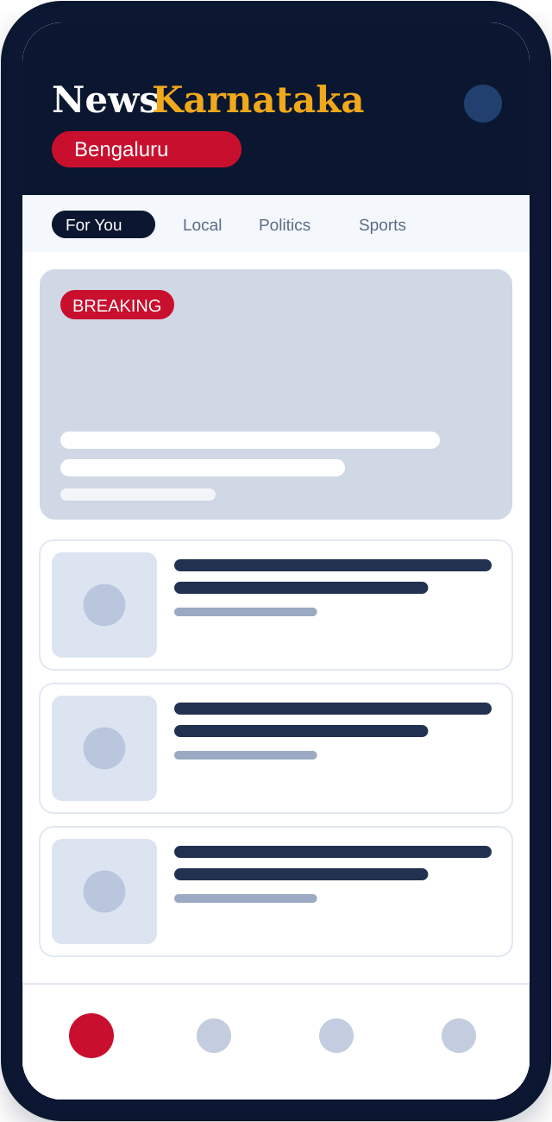


PART 02 · THE PRODUCT
Reading experience
The feed and the story page — where 90% of session time is spent.
A feed built per reader
Location weighting, reading history and followed topics combine into one ranked list. Pull to refresh; infinite scroll with position memory.
Breaking news that looks urgent
A distinct breaking treatment at the top of the feed, with a live-updating ticker for developing stories.
A story page that respects the reader
Clean typography, adjustable text size, inline media, reading-time estimate and a related-stories rail that keeps the session going.
Works on a weak connection
Stories and images cache locally; saved articles are fully readable offline, and the app opens to cached content instantly.
Notifications the reader chooses
Per-city and per-topic alerts, breaking-news toggle, and quiet hours — so push stays welcome instead of becoming noise.
Illustrative UI — real designs in week 1
Advanced News Platform · Proposal for News Karnataka
Opus Infinite
11
Notes:
Mockups are indicative only; week 1 produces the real Figma designs against the News Karnataka brand.

Slide 12
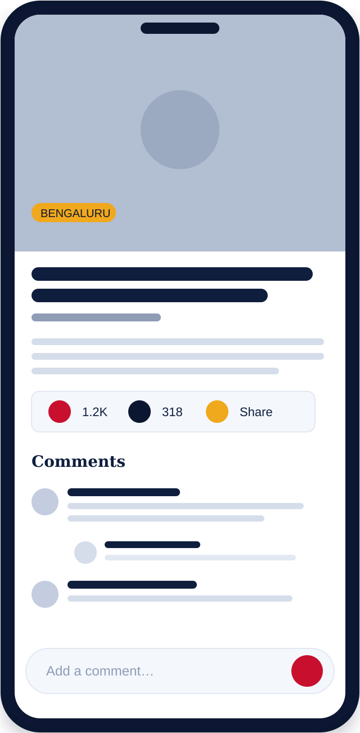

PART 02 · THE PRODUCT
Engagement & community
Comments are the cheapest retention feature in news — and the easiest to get wrong.
Threaded discussion
Reactions & bookmarks
Nested replies up to five levels, collapsed by default.
Upvotes, @mentions and sort by top or newest.
Verified badges for phone-verified readers.
Lightweight reactions for the majority who never comment.
Bookmarks in reading lists, synced across devices.
Both signals feed back into feed ranking.
Moderation editors can live with
Sharing that brings readers back
Automated first pass flags abuse and spam in both languages.
One queue with bulk approve, hide, shadow-ban and appeal trail.
Comments closable per story or per category.
One-tap share to WhatsApp, Instagram, X, Facebook and email.
Rich link previews with headline, image and attribution.
Deep links open the story in-app, or a fast web page when not installed.
Advanced News Platform · Proposal for News Karnataka
Opus Infinite
12
Notes:
Moderation is the objection you will get from the editorial side. Answer it before it is asked.

Slide 13
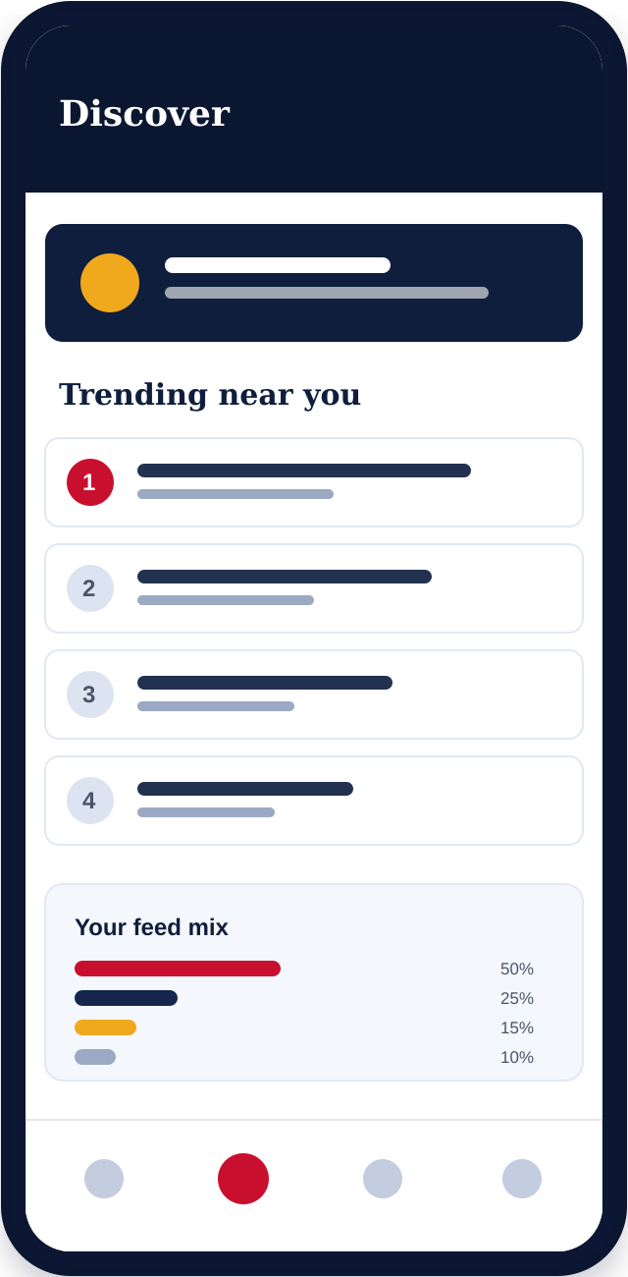




PART 02 · THE PRODUCT
Discovery & personalisation
Helping readers find the story they didn't know they wanted.
Search that understands Kannada
A profile worth creating
Full-text search across both languages with transliteration, autocomplete and typo tolerance — a reader can type 'Mangalore' or 'ಮಂಗಳೂರು' and land in the same place.
Avatar, followed cities and topics, reading history, saved lists — plus a personal reading-stats view that quietly drives return visits.
Trending, scoped to a city
Preferences that actually change the feed
A live trending section per city and per category, with a 24-hour view of what the reader's neighbours are actually reading.
Language, cities, category weights, notification rules and quiet hours, all in one settings screen with an immediate visible effect.
Browse with intent
Transparent, not creepy
Category and city landing pages, topic follows, journalist follows, and date filters for readers researching a running story.
A 'why am I seeing this' explanation on personalised cards, and a one-tap reset of the personalisation profile.
Advanced News Platform · Proposal for News Karnataka
Opus Infinite
13
Notes:
The 'why am I seeing this' control is a differentiator with editorially-minded buyers and helps with DPDP transparency obligations.

Slide 14


PART 02 · THE PRODUCT
Kannada + English, by design
You have run two editions since 2013. The app treats that as a core axis, not a setting.
One app, two full editions
Typography that renders properly
Complete Kannada and English UI throughout.
Language switch is instant and keeps the reader's place.
Reader language is honoured on every device.
Noto Sans Kannada for correct conjunct rendering, with line heights tested so headlines never clip.
Independent text-size control per script.
Numerals, dates and place names localised, not machine-translated.
Content linked across editions
Alerts in the reader's language
Kannada and English versions of a story are linked, so readers switch in place.
Where only one edition exists, the feed says so rather than showing a gap.
Search, tags and trending span both editions.
Push notifications composed and delivered per language segment.
Editors write both versions in one console screen.
Breaking-news pushes target a language and a city together.
Hindi, Tulu or Konkani editions can be added later without re-architecting — the language layer is built to take an nth language from the start.
Advanced News Platform · Proposal for News Karnataka
Opus Infinite
14
Notes:
This slide did not exist in the earlier draft and is one of the strongest differentiators for this specific client.

Slide 15

PART 02 · THE PRODUCT
Newsroom console
The app is only as fast as the newsroom behind it. Editors get their own tool.
Publish & schedule
Review the AI's work
Moderate at speed
Compose or import a story, attach media, set city and category tags, schedule ahead, and push a breaking alert — all without a developer.
Every auto-assigned location and topic tag is shown for one-click confirm or correction. Editors always have the final word.
A single queue for flagged comments with bulk actions, reader history and an audit trail on every decision.
See what's working
Roles & permissions
Commercial controls
Live reads by story, city and language; scroll depth; share and comment rates — visible to the desk, not just to analysts.
Reporter, sub-editor, editor and admin roles with scoped rights, so trainees can draft but not publish.
Ad slot management, house-ad scheduling, subscriber counts and paywall rules, in the same console.
Integration note: if News Karnataka keeps its current CMS, the console reads from it through an adapter rather than replacing it. We confirm the route in week 1 after a systems review.
Advanced News Platform · Proposal for News Karnataka
Opus Infinite
15
Notes:
Ask early which CMS is in use — it is the single biggest unknown affecting the week 1–2 estimate.

Slide 16
Solution architecture
PART 03
1
Technology
Technology stack
2
Infrastructure & scale
3
Proven components, assembled conservatively. Nothing here is a science experiment.
Security, privacy & compliance
4
Performance & SLA
5
Advanced News Platform · Proposal for News Karnataka
Opus Infinite
16

Slide 17
PART 03 · TECHNOLOGY
Solution architecture
Five layers, each independently scalable and independently replaceable.
CLIENTS
iOS app
Android app
Web app
PWA
Newsroom console
Flutter
Flutter
Next.js
Installable
React
EDGE & API
CDN & WAF
API gateway
REST + GraphQL
WebSocket
Push
Cloudflare
Auth · rate limits
Node · TypeScript
Live updates
FCM · APNs
SERVICES
Content
Identity
Engagement
Monetisation
Notification
Stories · media
Accounts · OTP
Comments · reactions
Ads · billing
Segments · sends
INTELLIGENCE
Classifier
Geo-tagger
Ranker
Trending
Feedback loop
Groq LLM
NER + gazetteer
Feature store
Rolling windows
Editor overrides
DATA
PostgreSQL
Redis
OpenSearch
Object storage
Warehouse
Source of truth
Cache · sessions
Full-text · bilingual
Media · backups
Analytics
Every layer is deployed independently, so the app can ship while the intelligence layer is still being tuned.
Advanced News Platform · Proposal for News Karnataka
Opus Infinite
17
Notes:
If asked about vendor lock-in: the Groq classifier sits behind our own interface and can be swapped for another provider or a self-hosted model without touching the apps.

Slide 18
PART 03 · TECHNOLOGY
Technology stack
Chosen for hiring depth and long-term maintainability, not novelty.
Layer | Choice | Why this one | Alternative considered
Mobile | Flutter 3.x | One codebase for iOS and Android at near-native performance; large Indian talent pool | React Native — weaker on list performance at feed scale
Web | Next.js 14 + React 18 | Server rendering for SEO, which matters enormously for a news publisher | Pure SPA — would cost you search traffic
Backend | Node.js + TypeScript | Shared types with the web client; fast iteration; easy to hire for | Go — faster, but slower to build and staff
Database | PostgreSQL 16 | Relational integrity for stories, users and billing, with JSON where useful | MongoDB — weaker for billing and reporting
Cache & queues | Redis | Feed caching, sessions, rate limits and job queues in one dependency | Memcached — no queues or data structures
Search | OpenSearch | Bilingual analysers for Kannada and English; faceting and typo tolerance | Postgres FTS — insufficient for Kannada
AI inference | Groq-hosted LLM | Sub-second classification at low cost per story; abstracted behind our own interface | Self-hosted — more control, more ops burden
Media & CDN | Object storage + Cloudflare | Cheap image and video delivery, format and size optimised automatically | Origin serving — slower and costlier at scale
Every choice is mainstream and well documented, so News Karnataka is never dependent on one vendor or one developer.
Advanced News Platform · Proposal for News Karnataka
Opus Infinite
18
Notes:
The 'alternative considered' column signals engineering judgement rather than fashion — it lands well with technical stakeholders.

Slide 19





PART 03 · TECHNOLOGY
Infrastructure, DevOps & scale
Built to hold a traffic spike on election night without a phone call.
Hosting
Continuous delivery
Scale & elasticity
Containerised services on managed Kubernetes in an India region, for latency and data residency.
Separate dev, staging and production from day one.
GitHub Actions pipelines with tests, linting and security scans on every pull request.
One-command deploy and rollback; no manual server changes, ever.
Horizontal autoscaling on API and feed services; database read replicas.
Feed and story caching, so a viral story is served from cache, not Postgres.
Observability
Backup & recovery
Handover
Central logs and metrics, with dashboards for latency, errors and queue depth.
Sentry for crashes; uptime alerts to an on-call rota during hypercare.
Daily backups with point-in-time recovery, rehearsed before launch not after an incident.
RPO and RTO targets documented and agreed in week 2.
All code in News Karnataka repositories; all infrastructure defined as code.
Runbooks and architecture docs shipped with the build — no key-person risk.
Note on cloud cost: hosting, CDN, AI inference and app-store fees are billed to News Karnataka directly at cost and sit outside the build price. We size and forecast them in week 2.
Advanced News Platform · Proposal for News Karnataka
Opus Infinite
19
Notes:
Being explicit that cloud cost is pass-through prevents an awkward conversation in month two.

Slide 20


PART 03 · TECHNOLOGY
Security, privacy & compliance
A digital news publisher carries obligations that a generic app does not.
Application security
DPDP Act readiness
TLS everywhere, encryption at rest, JWT sessions with refresh rotation, and OWASP Top 10 controls verified by automated scans plus a manual review in week 7.
Explicit consent capture, a stated purpose for every data field collected, data-minimisation by default, and self-service export and account deletion for readers.
Access & secrets
IT Rules obligations
Least-privilege roles, no shared credentials, secrets held in a managed vault, and full audit logs on every console action.
Grievance officer contact surfaced in-app, a takedown and correction workflow with timestamps, and a comment-moderation audit trail that stands up to scrutiny.
Abuse resistance
Editorial integrity in the product
Rate limiting, bot detection, WAF rules and DDoS protection at the edge — a news site is a target on the days it matters most.
Visible corrections on updated stories, clear sponsored-content labelling, and bylines and timestamps on every article — your published policies, enforced by the UI.
We build to these requirements as engineering practice. Final legal sign-off on privacy policy, consent wording and grievance process rests with your counsel — we provide the technical implementation and the documentation they will ask for.
Advanced News Platform · Proposal for News Karnataka
Opus Infinite
20
Notes:
Do not overclaim legal compliance. The disclaimer at the bottom is deliberate and should stay.

Slide 21
PART 03 · TECHNOLOGY
Performance targets & service levels
Numbers we commit to and measure, not aspirations.
< 2.0s
< 1.5s
< 300ms
99.5%
Cold app start
Feed first paint
API p95 latency
Monthly uptime
On a mid-range Android device
From cache on repeat opens
Feed and story endpoints
Measured by external monitoring
Load scenario | Target | How we get there | Verified
Normal day | 5,000 concurrent readers | Cached feeds, CDN-served media, two API replicas | Load test, week 7
Breaking news spike | 25,000 concurrent readers | Autoscaling plus a static breaking-story path that bypasses personalisation | Spike test, week 7
Election-night peak | 50,000 concurrent readers | Pre-warmed capacity, read replicas, degraded-mode feed as a last resort | Rehearsed pre-launch
AI service outage | No reader impact | Feed falls back to editorial ordering; tagging queues and drains on recovery | Chaos test, week 7
Performance budgets are enforced in CI — a pull request that pushes cold start past 2.0 seconds fails the build rather than reaching production.
Advanced News Platform · Proposal for News Karnataka
Opus Infinite
21
Notes:
The degraded-mode answer is the one that impresses technical buyers. Uptime SLA applies post-launch under AMC.

Slide 22
Three revenue streams
PART 04
1
Business Case
Advertising & real estate
2
Subscriptions
3
How the platform pays for itself, and how we will know whether it is working.
Revenue ramp
4
Success metrics
5
Advanced News Platform · Proposal for News Karnataka
Opus Infinite
22

Slide 23


PART 04 · BUSINESS CASE
Three revenue streams, live at launch
Diversified deliberately — no single stream carries the business.
Advertising
Subscriptions
Classifieds
Largest and fastest
Highest margin
Highest local leverage
Geo- and interest-targeted display, native and video inventory.
Direct-sold at premium rates, with programmatic backfill for unsold slots.
Sponsored articles and takeovers, clearly labelled.
Ad-free reading, offline downloads and early access.
Recurring, predictable revenue independent of ad market cycles.
Three tiers so price is never the reason a reader says no.
Geo-targeted property listings alongside a property news section.
Local builder and realtor partnerships, priced per city.
Extends naturally to jobs, education and matrimonial verticals.
Live from week 8
Live from week 8
Phase 2 candidate
Classifieds is scoped in this proposal as an integration-ready module: the listing model, geo-targeting and ad slots are built, while partner onboarding and sales run in parallel with your commercial team.
Advanced News Platform · Proposal for News Karnataka
Opus Infinite
23
Notes:
Be honest that classifieds revenue depends on partner sales, not just on software. It protects credibility on the projections slide.

Slide 24
PART 04 · BUSINESS CASE
Advertising & the real-estate vertical
Why a logged-in local audience sells for more than an anonymous one.
Inventory | Placement | Why it earns | Guardrail
Display banners | Feed positions 3 and 9, story footer | Geo- and category-targeted, so a Mangaluru advertiser pays only for Mangaluru readers | Frequency-capped; never above the fold on a story
Native / sponsored | In-feed cards and full sponsored articles | Reads like editorial and performs several times better than banners | Always labelled 'Sponsored'; separate from editorial ranking
Video pre-roll | Before video stories | Highest CPM inventory on the platform | Skippable after 5 seconds; capped once per session
Property listings | Dedicated real-estate section and in-feed cards | Local builders pay for intent-qualified reach in a specific city | Listings clearly separated from property news coverage
House ads | Any unsold slot | Unsold inventory promotes your own subscriptions instead of showing blank space | Managed by editors from the console
Targeting depth
Advertiser reporting
Reader experience first
City, category, language, time of day and reader interest — sold as a package rather than as impressions.
A self-serve dashboard for direct advertisers: impressions, clicks and reach by city.
Hard limits on ad density per screen. An app abandoned over ad load earns nothing at all.
Advanced News Platform · Proposal for News Karnataka
Opus Infinite
24
Notes:
The guardrail column reassures the editorial side that monetisation will not wreck the product.

Slide 25


PART 04 · BUSINESS CASE
Subscription tiers
A free tier that stays genuinely useful, and two paid tiers worth upgrading to.
Free
Plus
POPULAR
Pro
₹0
₹99
₹199
The default experience
per month
per month
Full access to all news
Everything in Free
Everything in Plus
Both languages
Completely ad-free
Unlimited offline downloads
Comments and bookmarks
Offline download — 100 stories a month
Personal reading analytics
Ad-supported
Early access to major stories
Newsletter and digest access
Standard push alerts
Priority push alerts
Ad-free across app and web
Reader acquisition
The volume tier
Power readers & professionals
Annual plans at a two-month discount, student pricing and a 7-day Plus trial. One subscription valid on app and web.
Advanced News Platform · Proposal for News Karnataka
Opus Infinite
25
Notes:
Reminder: app stores take 15–30%. Web-first billing where permitted keeps more margin — flag this in commercial discussion.

Slide 26
PART 04 · BUSINESS CASE
Revenue ramp — first twelve months
An illustrative model, not a forecast. Every input is a lever you control.
The five inputs that move this chart
Downloads
50,000 in month 3, 150,000 by month 12
Daily active readers
20% of installs, rising with push
Ad fill rate
60% at launch, 85% by month 6
Paid conversion
1% of monthly actives on Plus or Pro
Classifieds partners
First 10 signed by month 3
Read this as a shape, not a promise. The figures are placeholders illustrating how the three streams compound once the platform is live; they are not a revenue commitment. We will replace them with a model built from your own traffic and ad-rate data before this proposal is finalised.
Advanced News Platform · Proposal for News Karnataka
Opus Infinite
26
Notes:
Do not let this chart be quoted as a forecast. Replace the values with client-data-based numbers before issuing the final version.

Slide 27
PART 04 · BUSINESS CASE
Success metrics
What we review together at 30, 90 and 180 days after launch.
Metric | Day 30 | Day 90 | Day 180 | Why it matters
App installs | 15,000 | 50,000 | 100,000 | Reach of the owned channel
Daily active readers | 3,000 | 10,000 | 22,000 | The number advertisers actually buy
Sessions per reader per week | 3.0 | 4.5 | 5.5 | Habit formation, the hardest thing to fake
Average session length | 3 min | 4 min | 5 min | Depth of engagement, not just clicks
Day-30 retention | 22% | 30% | 35% | The single best predictor of long-term value
Comments per 100 readers | 2 | 5 | 8 | Community health
Paid conversion | 0.3% | 1.0% | 1.6% | Subscription revenue trajectory
Store rating | 4.0+ | 4.2+ | 4.3+ | Organic install rate depends on it
Instrumented from day one. Every metric above is wired into the analytics dashboard during the build, so the first review meeting reads real numbers rather than estimates. Targets are set jointly in week 2 and adjusted against actual launch traffic.
Advanced News Platform · Proposal for News Karnataka
Opus Infinite
27
Notes:
Targets are ambitious but defensible for a publisher with an existing audience to convert. Adjust once the client shares current web traffic.

Slide 28
1
8-week plan
2
Weeks 1–4
PART 05
3
Weeks 5–8
Delivery & Commercials
4
Team & governance
5
Investment summary
6
Payment milestones & AMC
Eight weeks, four sprints, a working demo at every gate — and what it costs.
7
Risks & assumptions
8
Deliverables & acceptance
9
Why Opus Infinite
10
Next steps
Advanced News Platform · Proposal for News Karnataka
Opus Infinite
28

Slide 29
PART 05 · DELIVERY
The eight-week plan
Four two-week sprints. Each ends in a demo you can click, not a status report you have to read.
W1
W2
W3
W4
W5
W6
W7
W8
Sprint 1
Sprint 2
Sprint 3
Sprint 4
Design & UX
Mobile apps
Web & PWA
Backend & APIs
AI & ranking
Newsroom console
Monetisation
QA & security
Launch & hypercare
Gates
Design signed off
Core app demo
AI + engagement demo
Store launch
Advanced News Platform · Proposal for News Karnataka
Opus Infinite
29
Notes:
Four gates, four demos. Gate 1 (design sign-off) is the one that most often slips — flag the 3-business-day feedback assumption here.

Slide 30
PART 05 · DELIVERY
Weeks 1–4 · Foundations and core product
By the end of week 4 you can read real stories on a real device.
Week 1
Week 2
Week 3
Week 4
Discovery & design
Foundations
Reading experience
Core services
Systems review: current CMS, content model, analytics and ad setup
Brand and design system in Figma, in both scripts
High-fidelity mockups of feed, story, search, profile and console
Database schema and API contract agreed
Repositories, CI/CD pipelines and three environments provisioned
PostgreSQL, Redis and OpenSearch stood up; content model migrated
Authentication service with phone-OTP and social login
Cloud cost forecast and backup/recovery targets confirmed with you
Flutter feed, story page, search and navigation built against live APIs
Next.js web app with server rendering and SEO metadata
Bilingual UI layer wired throughout, both scripts rendering correctly
Media pipeline: upload, resize, CDN delivery
Feed, story, category and search APIs with Redis caching
Newsroom console v1: publish, schedule, tag, upload
Push notification infrastructure with segment targeting
First internal build distributed to your team on TestFlight and Play Internal
Gate 1 — design sign-off
Gate 2 — core app demo
Weekly written status every Friday, a 30-minute review call every Monday, and standing access to the project board throughout.
Advanced News Platform · Proposal for News Karnataka
Opus Infinite
30
Notes:
Week 1 discovery output determines whether the console replaces or wraps the existing CMS.

Slide 31
PART 05 · DELIVERY
Weeks 5–8 · Intelligence, hardening and launch
By the end of week 8 the apps are public and earning.
Week 5
Week 6
Week 7
Week 8
AI & ranking
Engagement & money
Hardening
Launch
Groq classification service live: topic, entity and urgency tagging
Geo-tagging with a Karnataka gazetteer, down to district level
Location-weighted ranking with the 50/25/15/10 default mix
Trending detection per city, with editor override in the console
Threaded comments, reactions and bookmarks across app and web
Automated plus human moderation queue, bilingual
Ad slots, house ads and sponsored-content labelling
Subscription billing on all three platforms, tested end to end
Automated test suite at 80%+ coverage on business logic
Load, spike and chaos tests to the targets on page 21
Security review, dependency audit and penetration test; findings fixed
Accessibility pass and performance budgets enforced in CI
Closed beta with 50 readers and your newsroom; feedback triaged
App Store and Play Store submission, listings in both languages
Production launch, web and PWA live, monitoring and on-call active
Hypercare begins: two weeks of priority response included
Gate 3 — AI + engagement demo
Gate 4 — store launch
Store review is the one date we do not control. We submit at the start of week 8 with all listing assets and policy declarations prepared, and the web app launches on schedule regardless.
Advanced News Platform · Proposal for News Karnataka
Opus Infinite
31
Notes:
Naming the store-review risk here, rather than in week 8, is what keeps the client's trust when Apple takes five days.

Slide 32





PART 05 · DELIVERY
Team & governance
Eleven people, one point of contact, and a decision path that does not stall.
Project lead
×1
Flutter engineers
×2
Web engineers
×2
Backend engineers
×2
Single point of contact, sprint planning, risk log, weekly reporting
iOS and Android apps, offline layer, push integration
Next.js web app, PWA, newsroom console
APIs, services, caching, integrations, billing
AI engineer
×1
DevOps engineer
×1
Product designer
×1
QA engineer
×1
Classification, geo-tagging, ranking and trending
Infrastructure, pipelines, monitoring, security hardening
Design system, screens, bilingual typography, accessibility
Test automation, device matrix, load and regression testing
Rhythm
Your side
Decision SLA
Escalation
Monday review call, Friday written status, sprint demo every second Friday.
One product owner empowered to decide, plus an editorial and a commercial reviewer.
Feedback within 3 business days at each gate; delays past that shift the timeline transparently.
Any blocker unresolved for 48 hours goes to both project leads with a written options paper.
Advanced News Platform · Proposal for News Karnataka
Opus Infinite
32
Notes:
The decision SLA is the most important line on this slide. It is also your protection if the client's feedback is slow.

Slide 33
PART 05 · DELIVERY
Investment summary
Priced by workstream so you can see exactly what each part of the build costs.
Workstream | What it covers | Effort | Investment
Discovery & design | Systems review, design system, all screens in both scripts, prototype | 2 weeks | ₹ ______
Mobile apps (iOS + Android) | Flutter build, offline layer, push, store submission for both stores | 5 weeks | ₹ ______
Web app & PWA | Next.js app with SSR and SEO, installable PWA | 5 weeks | ₹ ______
Backend & APIs | Services, caching, search, media pipeline, integrations | 5 weeks | ₹ ______
AI & ranking layer | Classification, geo-tagging, personalised ranking, trending | 3 weeks | ₹ ______
Newsroom console | Publishing, moderation, analytics and commercial controls | 3 weeks | ₹ ______
Monetisation | Ad serving, subscription billing, classifieds module | 3 weeks | ₹ ______
QA, security & launch | Test automation, load and penetration testing, beta, launch | 3 weeks | ₹ ______
Total build | Fixed price for the scope defined in this document | 8 weeks | ₹ ______
INCLUDED
EXCLUDED
AFTER LAUNCH
All eleven roles, project management, two weeks of hypercare, source code, documentation
Cloud, CDN and AI inference costs, app-store fees, paid marketing, content licences
Optional AMC at 20% of build price per year
Advanced News Platform · Proposal for News Karnataka
Opus Infinite
33
Notes:
PRICING PLACEHOLDERS: replace every ₹ ______ before sending. Effort figures are elapsed weeks per workstream, running in parallel, not additive person-weeks.

Slide 34
PART 05 · DELIVERY
Payment milestones & annual maintenance
Payment tied to delivered gates, so your exposure tracks our progress.
25%
25%
25%
25%
On signature
Gate 1 — design sign-off
Gate 3 — AI + engagement demo
Gate 4 — store launch
Kickoff, team allocation, environments provisioned
All screens approved in Figma, both scripts
Working build with AI ranking and comments live
Apps submitted, web live, documentation handed over
Annual maintenance contract — 20% of build price per year
Keep it running
Keep it safe
Keep it improving
Keep you informed
Bug fixes with defined response times
OS and dependency upgrades
Server and database maintenance
Quarterly security and dependency audits
Incident response to an agreed RTO
Backup and restore drills
A pool of enhancement hours each quarter
AI retuning as reading patterns shift
A/B tests on feed and paywall
Monthly performance and revenue report
Quarterly roadmap review
Named contact and escalation path
Advanced News Platform · Proposal for News Karnataka
Opus Infinite
34
Notes:
AMC is optional and begins after the two weeks of included hypercare; response-time tiers and the enhancement-hour pool are agreed before it starts. Milestone split is 25/25/25/25 — a change from the earlier draft's 50% advance, which is a hard sell and weakens your position at gate 1.

Slide 35
PART 05 · DELIVERY
Assumptions, risks & mitigations
The things that could move the date, named now rather than discovered in week 6.
Risk or assumption | Impact | Why it could happen | How we handle it
Feedback slower than 3 business days at a gate | High | Multiple stakeholders, festival season, newsroom pressure | Named product owner with decision authority; timeline shifts transparently, logged at the gate
Existing CMS harder to integrate than expected | High | Unknown until the week 1 systems review | Adapter-first design; if integration is unviable we ship the console as the primary CMS, decided in week 1
App Store or Play review delay or rejection | Medium | Policy review on news apps, UGC and subscriptions | Submit at start of week 8 with policy declarations pre-checked; web and PWA launch regardless
Kannada content quality for AI tagging | Medium | Fewer pretrained resources for Kannada NER | Gazetteer-backed geo-tagging plus editor confirmation; accuracy measured and reported weekly from week 5
Scope growth during the build | Medium | Good ideas surface once people can click a real app | Written change-control: anything new is estimated and either swapped in or scheduled for phase 2
Ad and classifieds revenue depends on sales | Medium | Software cannot sign advertisers | We deliver the inventory, targeting and reporting; your commercial team runs sales, supported by our dashboards
Also assumed: News Karnataka provides brand assets and content API access in week 1, owns the cloud and store accounts, and nominates the editorial and commercial reviewers before kickoff. All third-party costs are billed to News Karnataka directly.
Advanced News Platform · Proposal for News Karnataka
Opus Infinite
35
Notes:
A risk slide raises credibility rather than lowering it. Walk through the top two and move on.

Slide 36




PART 05 · DELIVERY
Deliverables & acceptance
Exactly what is handed over, and what has to be true for it to be accepted.
Product
Engineering
Documentation
Acceptance criteria
iOS app live on the App Store
All source code in your repositories
Architecture and data-model docs
All page-6 objective tests passed
Android app live on Google Play
Infrastructure defined as code
API reference for all endpoints
Page-21 performance targets met under test
Responsive web app on your domain
CI/CD pipelines and environments
Newsroom console user guide, bilingual
Zero open critical or high-severity defects
Installable PWA with offline support
Automated test suite, 80%+ on logic
Operations runbooks and on-call guide
Security review findings closed
Newsroom console, role-based access
Load, security and chaos test reports
Figma design system and all screens
Editors trained and publishing unaided
Handover includes a live walkthrough with your engineering and editorial teams, plus recorded training sessions your staff can revisit.
Advanced News Platform · Proposal for News Karnataka
Opus Infinite
36
Notes:
Cross-references to pages 6 and 21 tie acceptance back to the objectives table — no ambiguity at sign-off.

Slide 37

PART 05 · DELIVERY
Why Opus Infinite
Four reasons this build lands on time and keeps working after we leave.
We ship, then we tune
Applied AI, not AI theatre
Eight weeks to a public launch with four clickable demos along the way. You judge progress by using the product, not by reading a status report.
The intelligence layer does four specific, measurable jobs and stays behind our own interface — so the model can be swapped without touching your apps.
Built for this market
No lock-in, by design
Kannada rendering, WhatsApp-first sharing, weak-connection performance and DPDP obligations designed in from week 1, not patched in after.
Your repositories, your cloud accounts, your data, mainstream technologies and complete documentation. AMC is a choice, never a dependency.
Our commitment: if any gate demo does not meet what this document promises, you may pause the engagement at that milestone with no further obligation.
Advanced News Platform · Proposal for News Karnataka
Opus Infinite
37
Notes:
Confirm the pause-at-gate commitment is commercially acceptable to you before issuing. It is a strong closer but it is a real obligation.

Slide 38
PART 05 · DELIVERY
Next steps
Four steps between this document and week 1 of the build.
1
THIS WEEK
2
WITHIN 1 WEEK
3
WITHIN 2 WEEKS
4
WEEK 8
Proposal walkthrough
Alignment & paperwork
Kickoff
Launch
A 60-minute session with your editorial and commercial leads
We answer questions and capture required changes
Confirm scope, price and any exclusions
Revised proposal issued with agreed scope and final pricing
Contract, NDA and payment schedule signed
Product owner and reviewers nominated
Kickoff workshop with both teams
Brand assets, CMS access and cloud accounts handed over
Environments provisioned; week 1 discovery begins
Apps submitted to both stores; web and PWA live
Editors trained and publishing unaided
Hypercare starts, AMC decision taken
What we need from you to hold the eight-week date: a nominated product owner with decision authority, brand assets and CMS access in week 1, feedback within three business days at each gate, and your store and cloud accounts ready before kickoff.
Advanced News Platform · Proposal for News Karnataka
Opus Infinite
38
Notes:
End on the ask. The bottom bar converts a nod in the room into four concrete client actions.

Slide 39


LET'S BUILD IT
Karnataka's news,
in every reader's pocket.
Walkthrough call this week
Revised proposal within a week
Kickoff inside a fortnight
Three platforms · Two languages · One AI-ranked, hyperlocal feed · Eight weeks
Opus Infinite
Product engineering & applied AI
+91 __________
Advanced News Platform · Proposal V1.0 · 03 September 2026 · Confidential
Notes:
Closing slide. Fill in the phone number and confirm the three asks before issuing.

